Slide 1
AIR POLLUTION MONITORING & RISK ANALYTICS
India Air Pollution Intelligence Dashboard
A data-driven view of pollution hotspots, risk patterns, monitoring performance and resource coverage
Hotspot Intelligence
Pollution Risk Surface
Incident Response Performance
04
01
02
03
Resource Deployment & Coverage
Team 3
Rushikesh Shirwalkar
Ajay Seepana
Rakesh Bomalla
Power BI Analytics Project

Slide 2
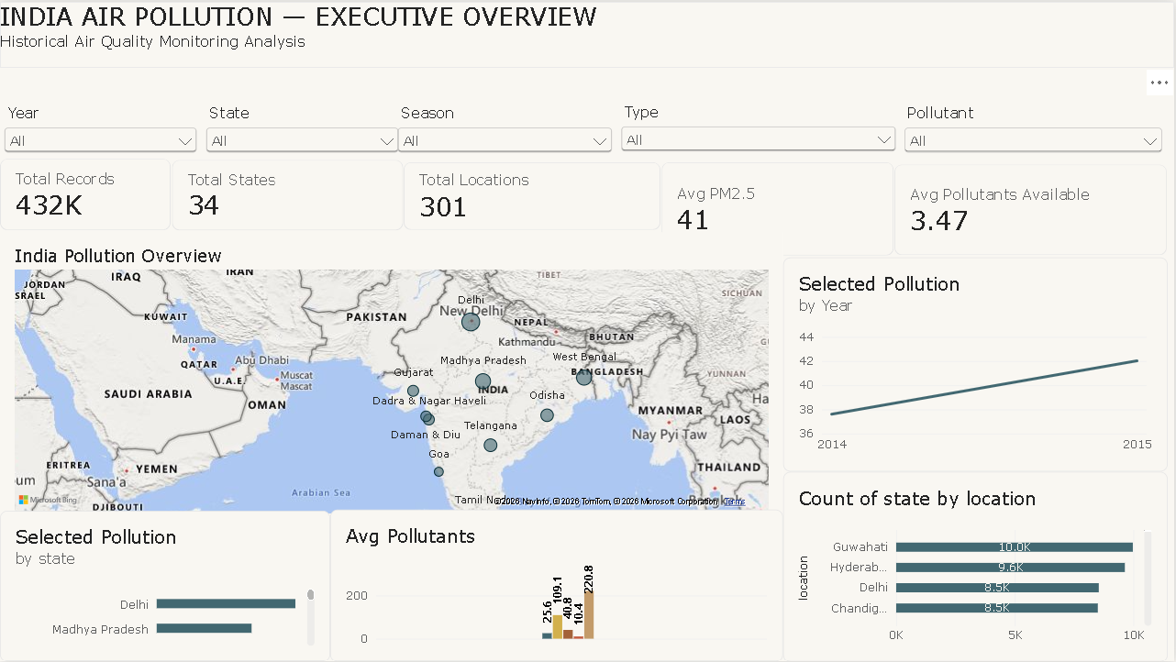

Slide 3
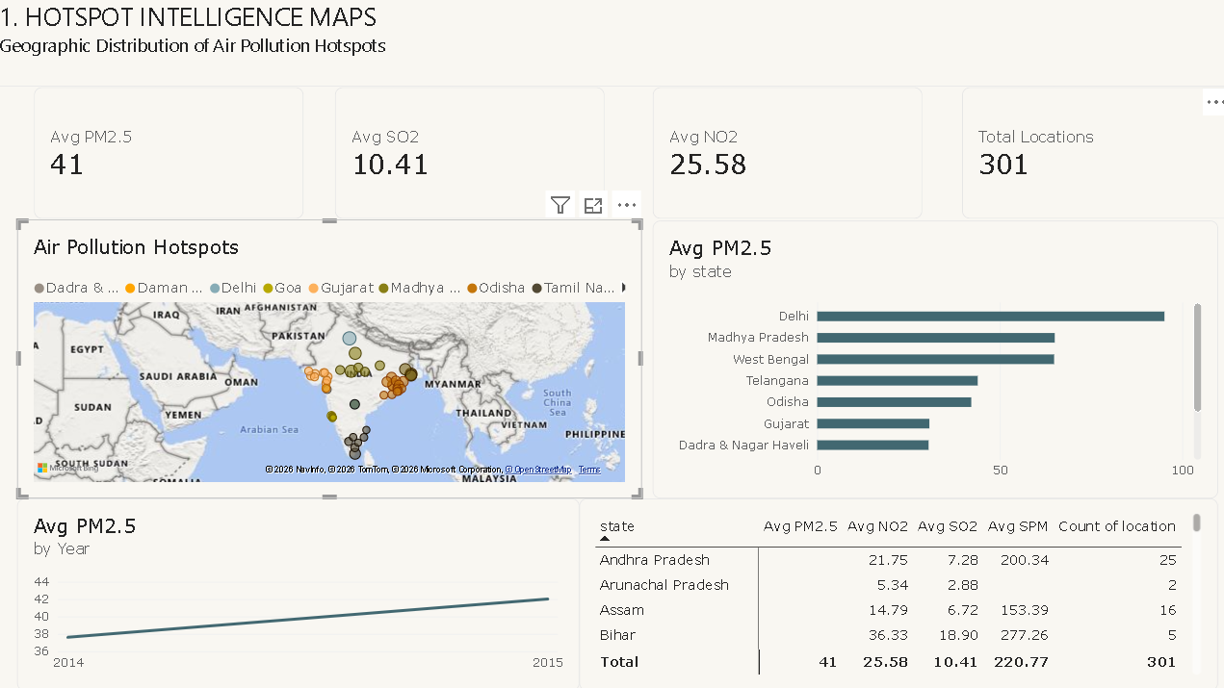

Slide 4
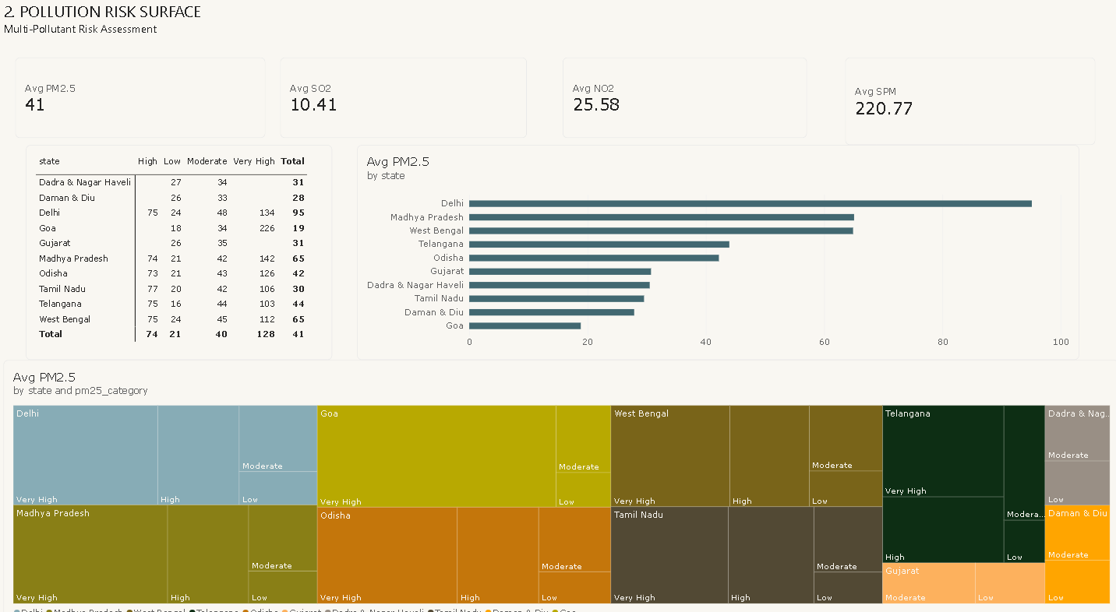

Slide 5
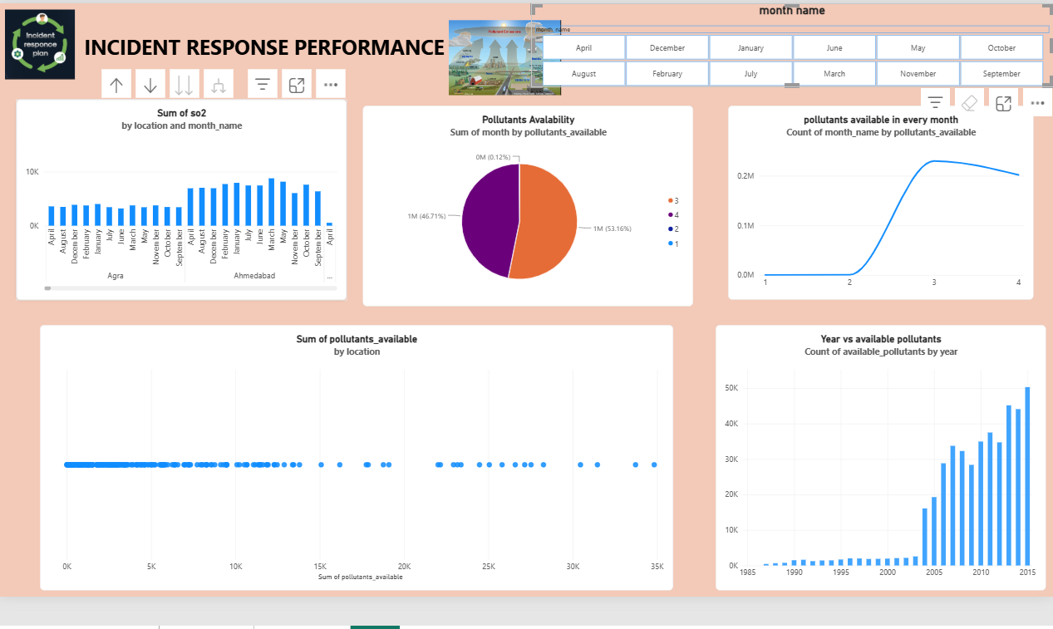

Slide 6
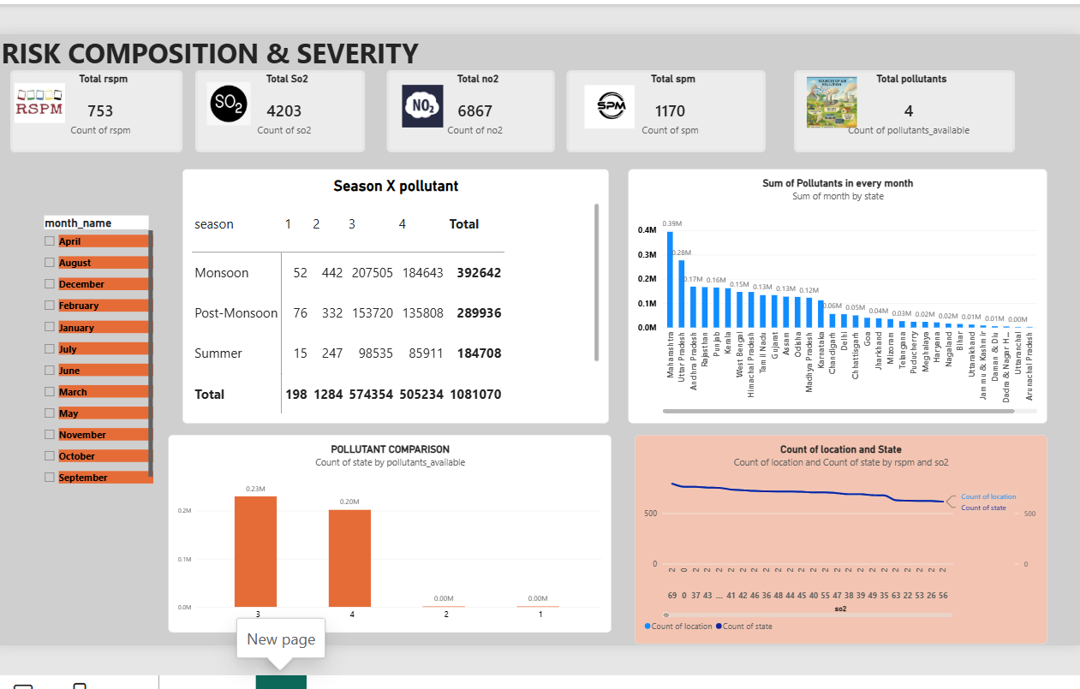

Slide 7
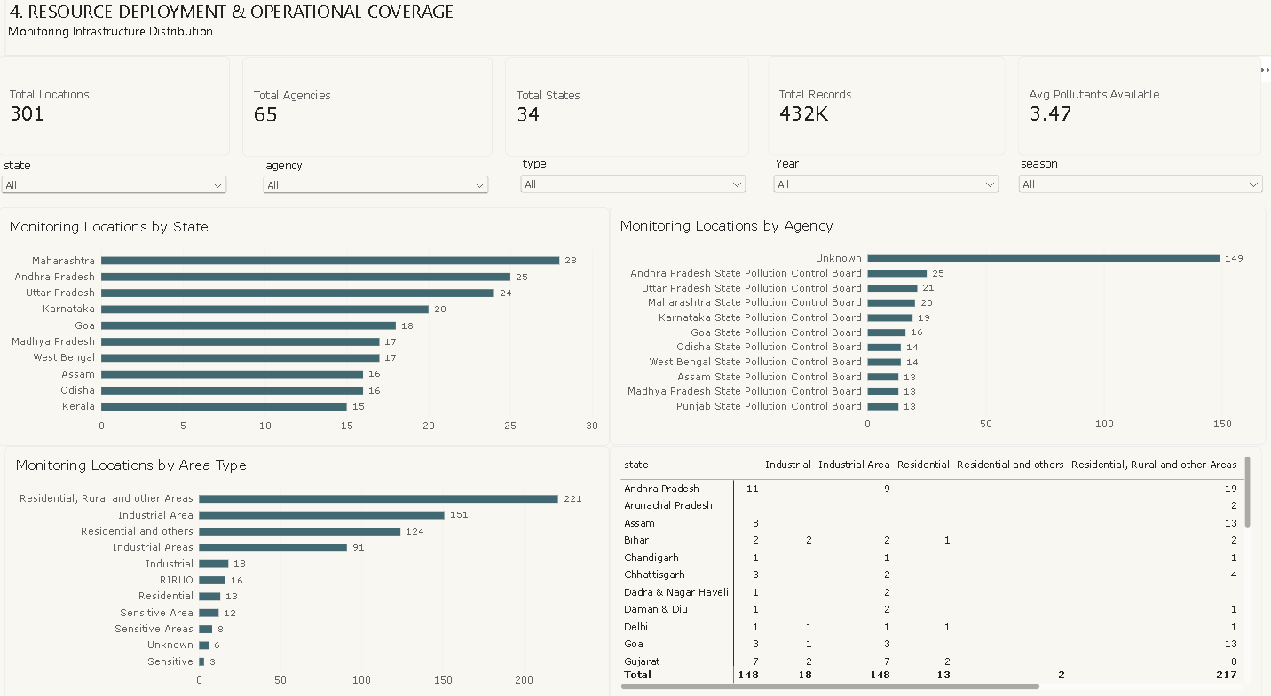

Slide 8
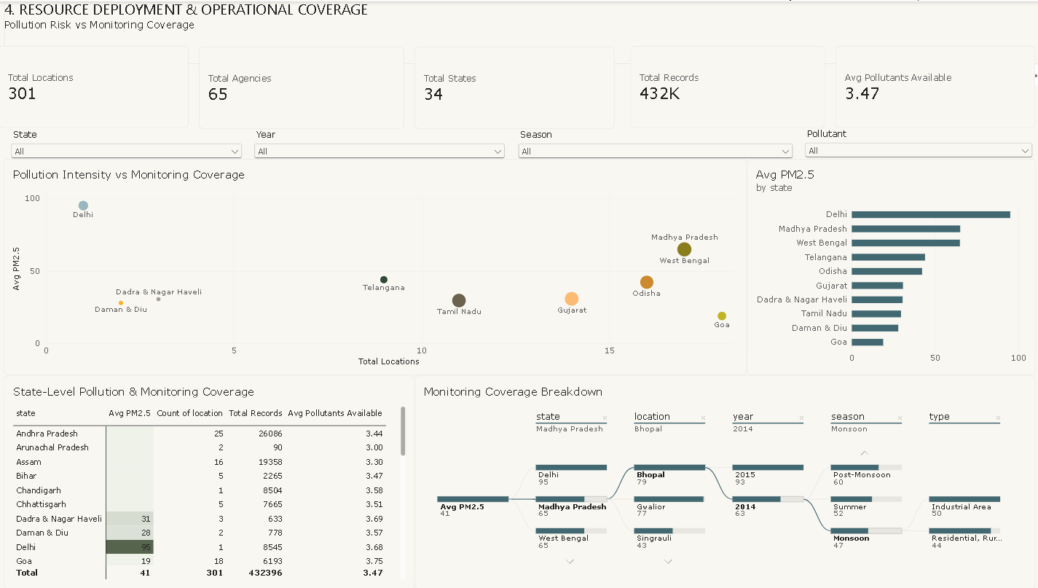

Slide 9
CONCLUSION & KEY INSIGHTS
From pollution measurement to actionable monitoring insight
01
Hotspots
Geographic analysis identifies where pollution intensity is concentrated and highlights priority areas for closer assessment.
02
Risk
Multi-pollutant analysis reveals how PM2.5 and other pollutants vary across states, locations and monitoring conditions.
03
Monitoring
Observation volume, pollutant availability and monitoring coverage provide a view of the monitoring network's operational readiness.
04
Resources
Comparing pollution intensity with monitoring coverage helps identify areas where further investigation of monitoring deployment may be warranted.
Overall takeaway: WHERE pollution occurs → HOW severe it is → HOW the monitoring network performs → WHERE resources are deployed.

